Slide 1
Video Frame Interpolation 视频插帧 2025/3/17
《Video frame interpolation: A comprehensive survey》
https://dl.acm.org/doi/abs/10.1145/3556544
Artificial Intelligence School of Beijing Normal university
Q1:如何通过计算机视觉和深度学习的方法生成视频序列中的中间帧以实现流畅的视觉效果？

Slide 2
Outline
Introduction
VFI methodology overview
Flow-based VFI
Kernel-based VFI
Hybrid flow-kernel-based VFI
Further Reading
Loss Function for Training Image Synthesis Task

Slide 3
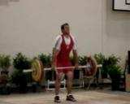
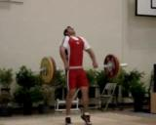
Introduction
Video Frame Interpolation (VFI):
在一段视频序列中，生成两个已有帧之间的中间帧
用于评估插值帧生成效果的指标:
时间上的平滑性, i.e. 插值误差↓, 归一化插值误差 ↓（这些衡量生成帧与真实帧在像素级别的接近程度）
视觉效果好, i.e. PSNR↑, SSIM↑ 这两个指标评估图像质量是否接近人眼认为的“真实图像”
插值帧应该对应这个动作过程的合理运动轨迹
?
…
?
Image source: Soomro, Khurram et al. “UCF101: A Dataset of 101 Human Actions Classes From Videos in The Wild.” ArXiv abs/1212.0402 (2012): n. pag.

Slide 4
Introduction
与视频帧插值（VFI）相关的其他计算机视觉任务: Q2(differece)
视频帧预测 (利用时间序列信息预测未来运动轨迹）
视频生成（基于输入图像的语义信息，构造一个完整的动作或场景变化过程）
prediction
generation
?
…
…
?
?
…
future
a whole content based on input frame’s semantic
Image source: Soomro, Khurram et al. “UCF101: A Dataset of 101 Human Actions Classes From Videos in The Wild.” ArXiv abs/1212.0402 (2012): n. pag.

Slide 5
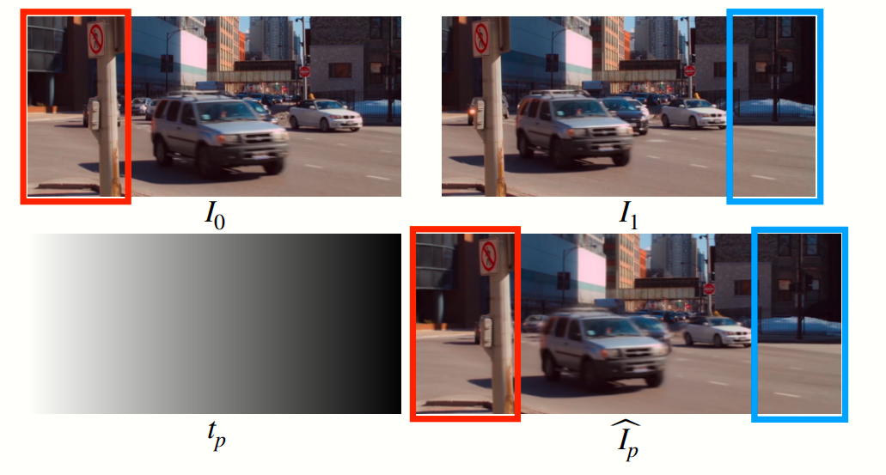
Introduction
Application:
提高视频帧率
生成慢动作内容
视频流中的帧恢复（用插值来补全因网络波动丢失的帧）
视频压缩
动态场景拼接
（将多个视频片段在动态环境下
拼接为连续场景）
Dynamic scene stitching
Reference: Huang, Zhewei et al. “Real-Time Intermediate Flow Estimation for Video Frame Interpolation.” European Conference on Computer Vision (2020).

Slide 6
VFI Methodology Overview
3 mainstream methodology(Q4,Q5):
Flow-based method
Kernel-based method
Hybrid flow-kernel-based method

Slide 7

VFI Methodology Overview
3 mainstream methodology:
Flow-based method
利用 光流（optical flow） 来估计帧间像素运动，从而生成中间帧
Remark: 光流表示从第一帧到第二帧中每个像素的运动向量
?
?
?
?
?
?
?
?
Frame 1
F_{1→2}
Frame 2

Slide 8
VFI Methodology Overview
3 mainstream methodology:
Flow-based method
利用 光流（optical flow） 来估计帧间像素运动，从而生成中间帧
将光流“缩放一半”，即取 0.5 倍光流，用它将帧1进行warp，从而生成中间帧
?
Warped by
?
0.5 x
=
?
?
?
?
?
?
Frame 1
F_{1→2}
Frame 1.5
Frame 2

Slide 9
VFI Methodology Overview
3 mainstream methodology:
Kernel-based method
使用局部自适应卷积核直接预测中间帧中每个像素的值, i.e. using Convolutional neural network / Vision Transformer.
(自适应局部卷积核实现端到端的插值生成)
模型为每个像素“学习”一个合适的卷积方式，从两张原图中抽取信息，合成一帧新图像
CNN
or
ViT
Frame 1
Frame 1.5
Frame 2

Slide 10
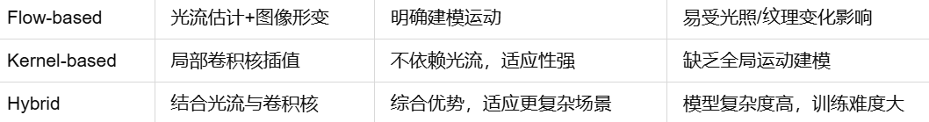
VFI Methodology Overview
3 mainstream methodology:
Hybrid flow-kernel-based method
Kernel-based 认为光流法在光照变化或纹理复杂时估计不准，导致插值质量差
Flow-based 卷积核法缺乏明确的运动建模，容易忽视帧间位移
光流提供明确的运动指导，卷积核增强纹理与细节合成能力

Slide 11

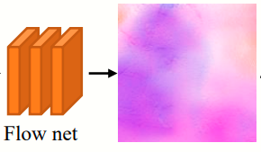

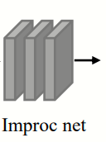

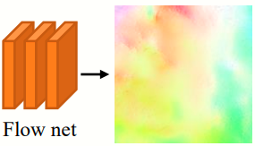
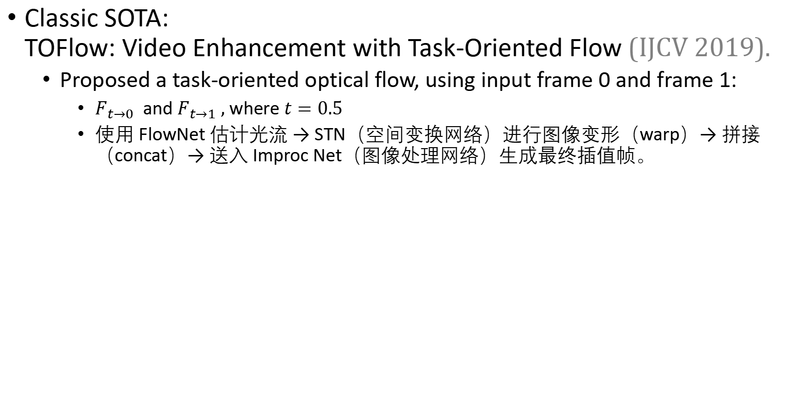
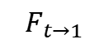
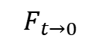
Flow-based VFI
Remark: STN: Spatial Transformer Network
concat: concatenate tensors along channel axis
Classic SOTA: TOFlow: Video Enhancement with Task-Oriented Flow (IJCV 2019).
Proposed a task-oriented optical flow, using input frame 0 and frame 1:
$F_{t→0}$ and $F_{t→1} ,$ where $t=0.5$
使用 FlowNet 估计光流 → STN（空间变换网络）进行图像变形（warp）→ 拼接（concat）→ 送入 Improc Net（图像处理网络）生成最终插值帧。
STN
Frame 0
$$F_{t→0}$$
concat
Frame 1
STN
Frame 0.5
$$F_{t→1}$$
Reference: Xue, Tianfan et al. “Video Enhancement with Task-Oriented Flow.” International Journal of Computer Vision (2017): 1-20.

Slide 12
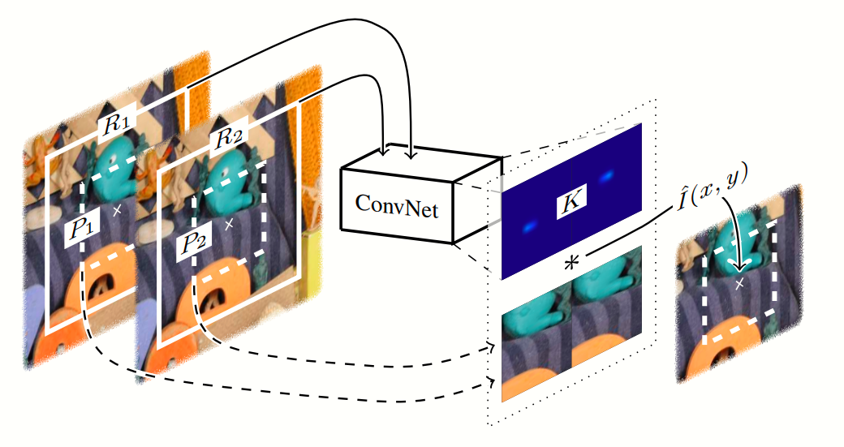
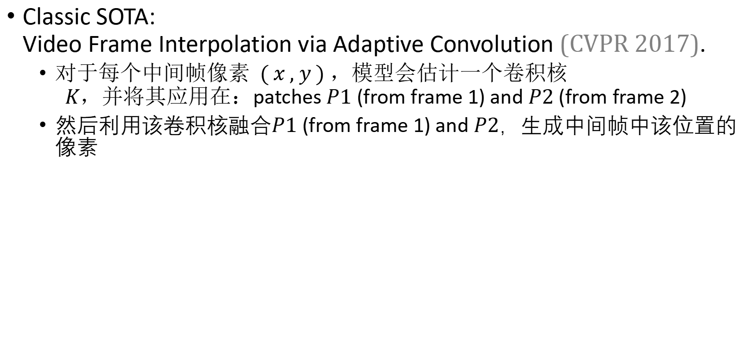
Kernel-based VFI
Classic SOTA: Video Frame Interpolation via Adaptive Convolution (CVPR 2017).
$对于每个中间帧像素 ( x , y ) ，模型会估计一个卷积核 K，并将其应用在：$patches $P1$ (from frame 1) and $P2$ (from frame 2)
然后利用该卷积核融合$P1$ (from frame 1) and $P2$，生成中间帧中该位置的像素
Reference: Niklaus, Simon et al. “Video Frame Interpolation via Adaptive Convolution.” 2017 IEEE Conference on Computer Vision and Pattern Recognition (CVPR) (2017).

Slide 13
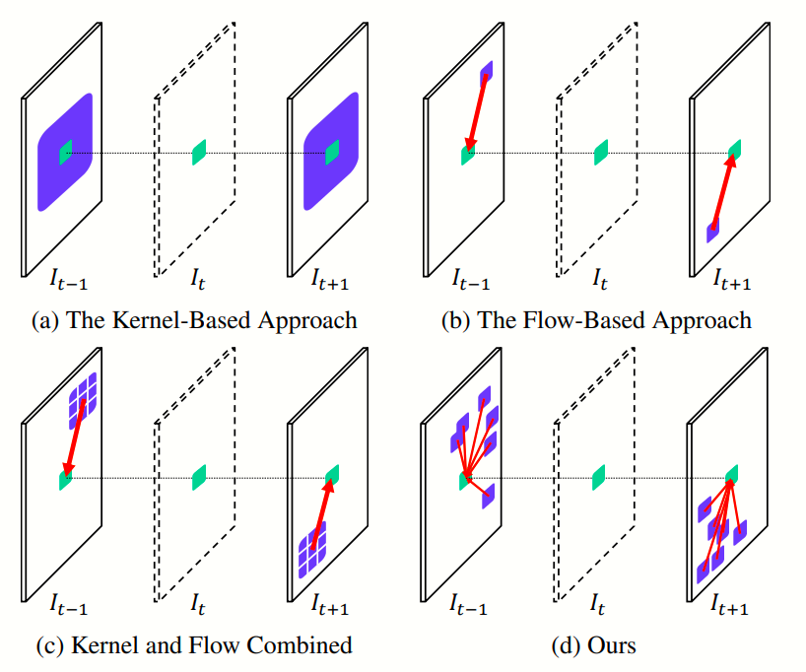
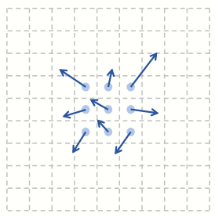
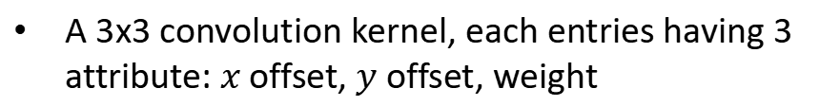
Hybrid Flow-kernel-based VFI
Classic SOTA: 流与卷积协同、结构更复杂，性能更强 AdaCoF: Adaptive Collaboration of Flows for Video Frame Interpolation (CVPR 2020).
任务导向的光流 + 可变形卷积
A 3x3 convolution kernel, each entries having 3 attribute: $x$ offset, $y$ offset, weight
Reference: Lee, Hyeongmin et al. “AdaCoF: Adaptive Collaboration of Flows for Video Frame Interpolation.” 2020 IEEE/CVF Conference on Computer Vision and Pattern Recognition (CVPR) (2019).

Slide 14
Further Reading
Flow-based method
Video frame synthesis using deep voxel flow (ICCV 2017)
Super Slomo (CVPR 2018)
ABME (ICCV 2021)
RIFE (ECCV 2022) Q7
Kernel-based method
Video frame interpolation via adaptive separable convolution (ICCV 2017)
CAIN (AAAI 2020)
Multiple video frame interpolation via enhanced deformable separable convolution (IEEE Trans. Pattern Anal. Mach. 2021)
Hybrid flow-kernel-based method
DAIN (CVPR 2019)
FILM (ECCV 2022)
VFIformer (CVPR 2022)

Slide 15
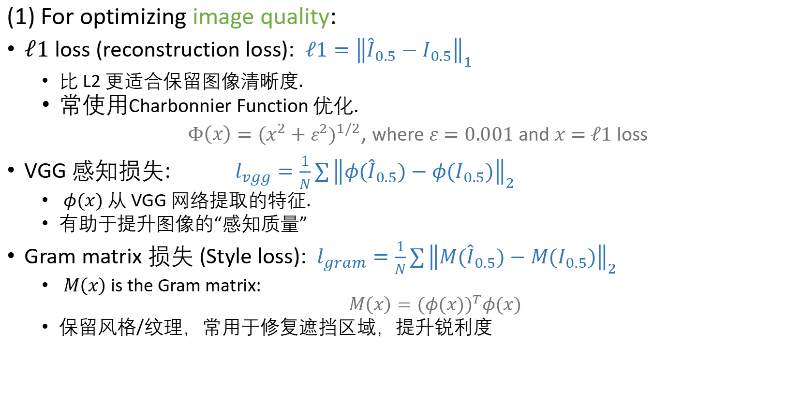
Loss Function for Training Image Synthesis Task
(1) For optimizing image quality:
$ℓ1$ loss (reconstruction loss): $ℓ1={\left\|{\hat{I}}_{0.5}−I_{0.5}\right\|}_{1}$
比 L2 更适合保留图像清晰度.
常使用Charbonnier Function 优化.
$Φ\left(x\right)={(x^{2}+ε^{2})}^{1/2}$, where $ε=0.001$ and $x=$ $ℓ1$ loss
VGG 感知损失: $l_{vgg}=\frac{1}{N}\sum{{\left\|φ{(\hat{I}}_{0.5})−φ(I_{0.5})\right\|}_{2}}$
$φ(x)$ 从 VGG 网络提取的特征.
有助于提升图像的“感知质量”
Gram matrix 损失 (Style loss): $l_{gram}=\frac{1}{N}\sum{{\left\|M{(\hat{I}}_{0.5})−M(I_{0.5})\right\|}_{2}}$
$M\left(x\right)$ is the Gram matrix:
$$M\left(x\right)=({φ(x))}^{T}φ(x)$$
保留风格/纹理，常用于修复遮挡区域，提升锐利度

Slide 16
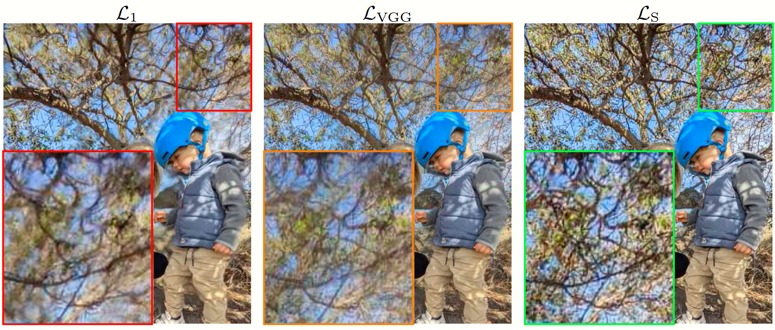
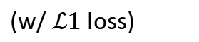
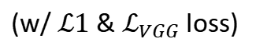
(Q6)Ablation Study:不同损失下的图像质量对比
(w/ $ℒ1$ loss)
(w/ $ℒ1$ & $ℒ_{VGG}$loss)
图像模糊，尤其是树枝、细节模糊不清
略带伪影 最清晰，纹理最完整，最真实
Reference: Reda, Fitsum A. et al. “FILM: Frame Interpolation for Large Motion.” Europe Conference on Computer Vision (ECCV) 2022.

Slide 17
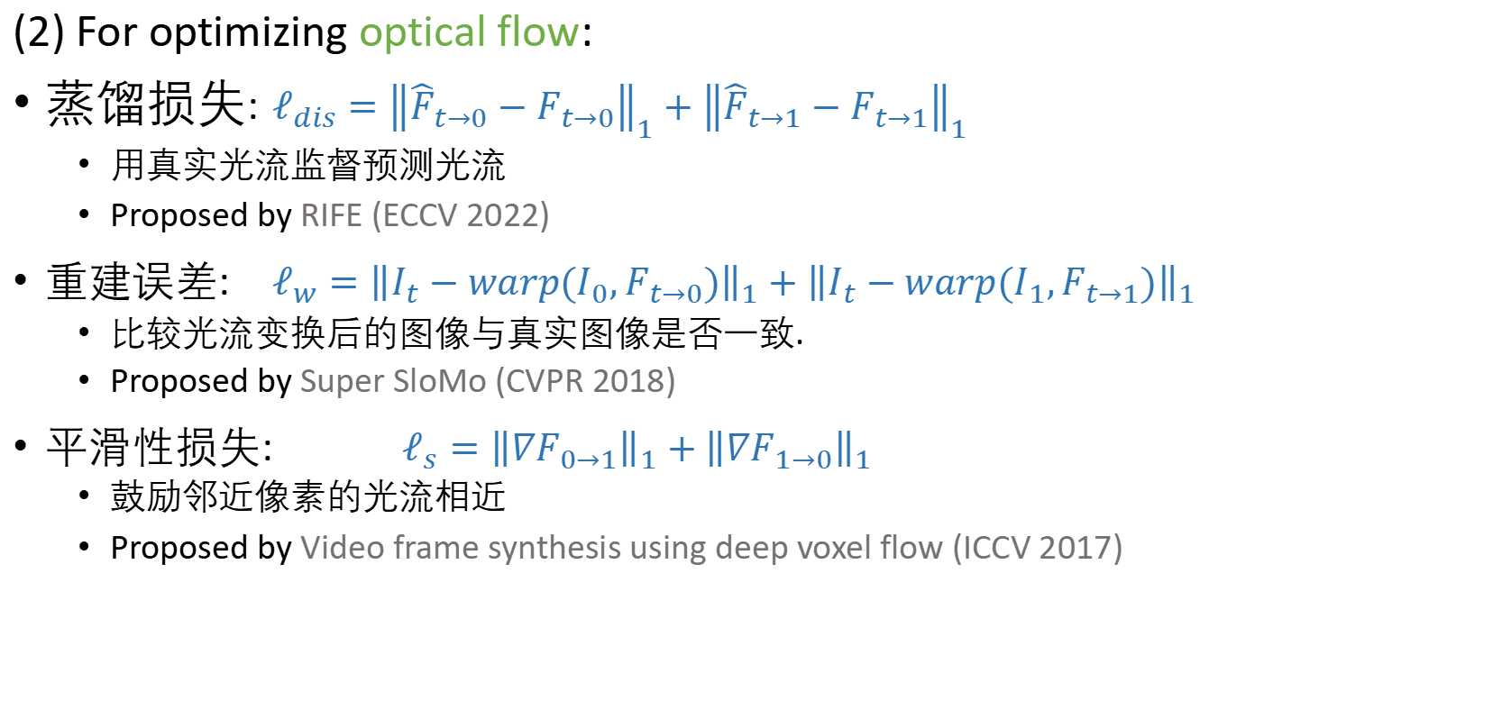
Loss Function for Training Image Synthesis Task
(2) For optimizing optical flow:
蒸馏损失: $ℓ_{dis}={\left\|{\hat{F}}_{t→0}−F_{t→0}\right\|}_{1}+{\left\|{\hat{F}}_{t→1}−F_{t→1}\right\|}_{1}$
用真实光流监督预测光流
Proposed by RIFE (ECCV 2022)
重建误差: $ℓ_{w}={\left\|I_{t}−warp(I_{0},F_{t→0})\right\|}_{1}+{\left\|I_{t}−warp(I_{1},F_{t→1})\right\|}_{1}$
比较光流变换后的图像与真实图像是否一致.
Proposed by Super SloMo (CVPR 2018)
平滑性损失: $ℓ_{s}={\left\|∇F_{0→1}\right\|}_{1}+{\left\|∇F_{1→0}\right\|}_{1}$
鼓励邻近像素的光流相近
Proposed by Video frame synthesis using deep voxel flow (ICCV 2017)
Reference: (1) Huang, Zhewei et al. “Real-Time Intermediate Flow Estimation for Video Frame Interpolation.” European Conference on Computer Vision (2020).
(2) Jiang, Huaizu et al. “Super SloMo: High Quality Estimation of Multiple Intermediate Frames for Video Interpolation.” 2018 IEEE/CVF Conference on Computer Vision and Pattern Recognition (2017).
(3) Liu, Ziwei et al. “Video Frame Synthesis Using Deep Voxel Flow.” 2017 IEEE International Conference on Computer Vision (ICCV) (2017): 4473-4481.

Slide 18
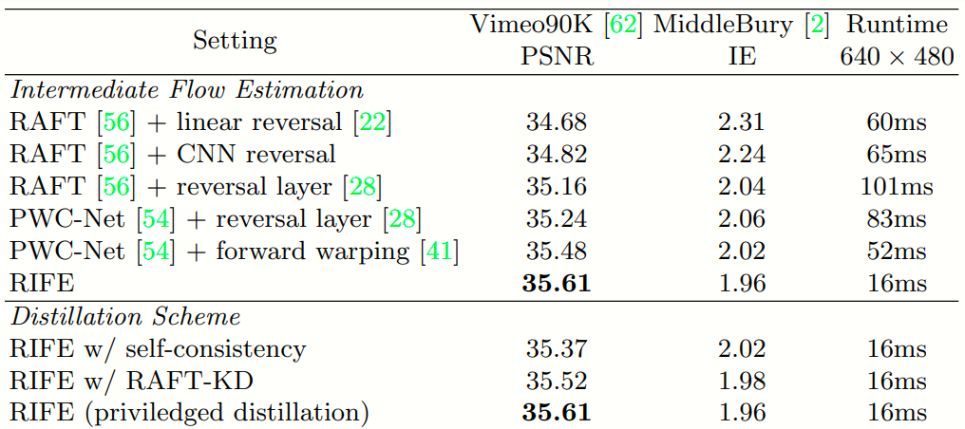
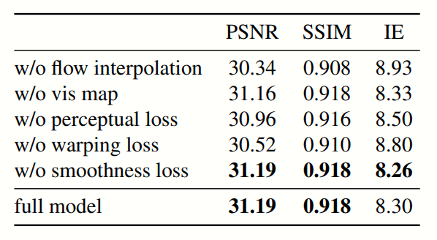
Ablation Study: 插值质量消融实验
Reference: (1) Huang, Zhewei et al. “Real-Time Intermediate Flow Estimation for Video Frame Interpolation.” European Conference on Computer Vision (2020).
(2) Jiang, Huaizu et al. “Super SloMo: High Quality Estimation of Multiple Intermediate Frames for Video Interpolation.” 2018 IEEE/CVF Conference on Computer Vision and Pattern Recognition (2017).

Slide 19
Thanks for listening.
Questions are welcome!

